Slide 1



EZ4YouTech.com
Close estimates and follow up faster
AI tools for HVAC, plumbing, and trade teams: estimate explainers, follow-up, and client email in one workflow
About 8 minutes of slides · Three live demos on the platform (~7 minutes)
Presented by: Mohd Naeem, Founder & CEO
25+ years in development, architecture, and DevSecOps. Enterprise experience, built for small business teams
www.ez4youtech.com · connect@ez4youtech.com · +1 (214) 404-2319

Slide 2
EZ4YouTech.com
AI MADE EASY FOR YOUR BUSINESS
Agenda
What we will cover in the next few minutes
Section | Topics | Time
1 | Problem · What we built · Keep what works · Sound familiar · How it works | ~3 min
2 | Three walkthroughs: Estimate · Reminders · Bulk Email (scenario, solution, demo on each slide) | ~8 min
3 | Common questions · Pilot · Pricing · Why trust us · AI Platform tech stack | ~4 min
4 | Your next step · Q&A | Open

Slide 3
EZ4YouTech.com
AI MADE EASY FOR YOUR BUSINESS
The problem
Tackle the daily work that slows you down
AI built for your industry
✓ We augment your existing tools (dispatch, estimating, and invoicing software). We do not replace them.
✓ Estimates, follow-ups, and dispatch notes in clear steps, not a blank ChatGPT tab
✓ Same workflow every time. Enter facts once, move to the next step. No re-typing between apps
✓ Human review before every send. Drafts only, not autopilot.
What we solve
Time · Money · Priority
✓ Time: hours back on estimate explanations and cold-quote follow-up
✓ Money: jobs won when homeowners understand the quote and hear back quickly
✓ Priority: finish office work that piles up while techs are in the field

Slide 4
EZ4YouTech.com
AI MADE EASY FOR YOUR BUSINESS
What we built
One login, home services apps, and everyday business tools
Your company workspace
Home Services Apps
Everyday Tools
✓ One business account
✓ Home services industry chosen once
✓ Team logins by plan
✓ Estimate explainers and service follow-up
✓ Work orders, dispatch handoff, maintenance plans
✓ Client Relationship Reminders and Bulk Email Processor
✓ Documents and seasonal campaigns
How It Feels After the Estimate
✓ Open Explain an estimate, run step one, tap Continue. The next app opens with your draft.
✓ Estimate Explainer, Service Follow-Up, and AI Email Automation: same path every job
✓ Your admin connects your AI account once (OpenAI, Together, Groq, xAI, and more)
✓ We augment your existing tools (dispatch, estimating, and invoicing software). We do not replace them.

Slide 5
EZ4YouTech.com
AI MADE EASY FOR YOUR BUSINESS
Keep what already works
Your existing tools, plus a writing and email layer
Your dispatch & field tools
Estimate & invoicing software
EZ4YouTech.com
Schedules, work orders, and tech notes stay where they are
Your pricing tools and homeowner portals
Plain-language estimates, follow-up, and email. Same path each time.
We augment your existing tools (dispatch, estimating, and invoicing software). We do not replace them.
Homeowners Understand · Quotes Close Faster · Less Office Typing

Slide 6
EZ4YouTech.com
AI MADE EASY FOR YOUR BUSINESS
Sound familiar?
Many offices paste estimate lines into ChatGPT and still re-type every homeowner email
Free ChatGPT or Copilot
With EZ4YouTech.com
✗ Open a blank chat and explain the repair every estimate
✗ Copy explanation, follow-up, and client email in separate steps
✗ Free ChatGPT or Copilot may use your prompts for training and model improvement
✗ You are tied to one provider and one personal account
✓ One estimate workflow: same steps every time with Continue
✓ Explain an estimate: Estimate Explainer, Service Follow-Up, AI Email Automation
✓ Your company workspace and your AI accounts. We do not train on your client data
✓ Your admin connects your provider once: OpenAI, Together, Groq, xAI, and more

Slide 7
EZ4YouTech.com
AI MADE EASY FOR YOUR BUSINESS
How it works
Three steps for your team. No IT project required.
1
2
3
Connect once
Explain an Estimate
Try free
✓ Your admin links your company's AI account once
✓ The whole office shares one secure workspace
✓ 2-month pilot with platform fee waived
✓ Test on real estimates before you decide
✓ Estimate Explainer → Service Follow-Up → AI Email Automation
✓ Tap Continue between steps. Same path every job.
You pay your AI provider directly. Our fee covers the apps and workspace, not your token usage.

Slide 8
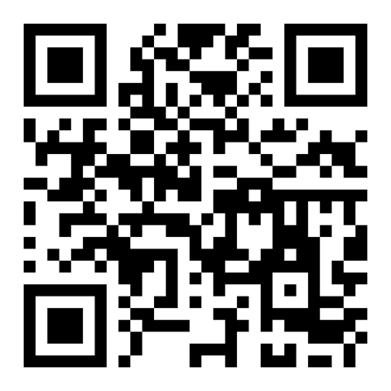
EZ4YouTech.com
AI MADE EASY FOR YOUR BUSINESS
Walkthrough 1: Explain an Estimate
Scenario 1
Solution 1: Estimate Workflow
The homeowner does not understand the line items. The quote goes cold.
Three steps, same path every job.
✗ Repair lines need plain English before the customer says yes.
✗ Open quotes sit for days with no follow-up email drafted.
✗ Dispatch notes never make it into a clear homeowner message.
✓ 1 · Estimate Explainer: Plain-language estimate explanation
✓ 2 · Service Follow-Up: Follow-up email draft for cold quotes
✓ 3 · AI Email Automation: Send homeowner email or copy to Outlook
Explain the estimate, draft follow-up, and send or paste into your tools in minutes.
Demo 1: Explain an Estimate
Live on the platform · About 3 minutes · Starter plan and above
✓ Open Explain an Estimate
✓ Estimate Explainer, Service Follow-Up, AI Email Automation
✓ Tap Continue between steps. Same path every job.
Scan to open
aiplatformusa.ez4youtech.com
Homeowners Understand · Quotes Close Faster · Less Office Typing

Slide 9
EZ4YouTech.com
AI MADE EASY FOR YOUR BUSINESS
Walkthrough 2: Client Follow-Up
Scenario 2
Solution 2: Client Reminder Workflow
Birthdays and anniversaries slip when daily estimate work stacks up.
Three steps from CSV to sent email.
✗ You mean to send birthday notes, but client work wins every week.
✗ Each email is written from scratch or copied from an old template.
✗ Your CRM has the dates. Turning them into send-ready drafts still takes time.
✓ 1 · Upload CSV: Rows ready for draft generation
✓ 2 · Review Drafts: Edit anything before you approve
✓ 3 · Send: Send approved emails from your account
Review drafts, send all due reminders, or set auto-send and forget the follow-up pain.
Demo 2: Client Reminders
Live on the platform · About 2 minutes · Growth plan and above
✓ Open Client Relationship Reminders
✓ Upload your client CSV and review draft emails.
✓ Approve and send from Microsoft 365.
Scan to open
aiplatformusa.ez4youtech.com
Stay in Touch · Clients Feel Remembered · Less Manual Typing

Slide 10
EZ4YouTech.com
AI MADE EASY FOR YOUR BUSINESS
Walkthrough 3: Inbox Backlog
Scenario 3
Solution 3: Bulk Email Workflow
Saved emails and replies pile up faster than you can write them.
Three steps from inbox to sent replies.
✗ Leads and client threads wait in your inbox or saved folder.
✗ Starting each reply from scratch eats the hour you needed for client work.
✗ Copy from ChatGPT still means paste, fix tone, and send one at a time.
✓ 1 · Import: Messages queued for drafting
✓ 2 · Review Drafts: Edit any message before you approve
✓ 3 · Send: Send from Microsoft 365
Batch draft replies, approve once, send from your inbox.
Demo 3: Bulk Email
Live on the platform · About 2 minutes · Full plan and above
✓ Open Bulk Email Processor
✓ Upload saved emails or sync inbox, review AI drafts
✓ Approve the batch and send.
Scan to open
aiplatformusa.ez4youtech.com
Clear the Backlog · Faster Replies · Less Copy-Paste

Slide 11
EZ4YouTech.com
AI MADE EASY FOR YOUR BUSINESS
Common questions
Plain answers we give owners and office managers
Already using ChatGPT?
Why another subscription?
✓ Same estimate workflow every job, not a blank chat each time
✓ Steps connect in one company workspace, not personal chats
✓ Our fee covers apps and workspace, not AI usage
✓ You pay your provider directly; 2-month pilot waives platform fee
We have dispatch software
Which plan fits us?
✓ Keep those tools. We finish estimate explanations and email
✓ Paste our drafts into your dispatch or CRM as you do today
✓ Starter: Setup admin + up to 2 app users
✓ Growth: up to 5 users · Full unlocks Bulk Email Processor

Slide 12
EZ4YouTech.com
AI MADE EASY FOR YOUR BUSINESS
Plans and Founding Rates
Free 2-month pilot · Founding rates for our first 50 customers
Plan | Regular | Founding | Team
Starter (Basic) | $39 | $29 | Admin + up to 2 app users
Growth (Standard) | $59 | $49 | Up to 5 app users
Full (Elite) | $119 | $99 | Up to 10 · Bulk Email Processor included
Enterprise | From $199 | From $149 | Up to 25 · contact us
Try free for 2 months
✓ Platform fee waived on Starter, Growth, or Full
✓ We help your admin connect AI once
✓ Run all three live demos on real work
✓ Founding rates lock for early adopters
AI usage is billed by your provider, not included in the platform fee.
Yearly billing saves one month · See ez4youtech.com/pricing

Slide 13
EZ4YouTech.com
AI MADE EASY FOR YOUR BUSINESS
Why trust EZ4YouTech.com
Built by a cloud developer and architect for small business teams
Founder credibility
Your data stays yours
Real apps, not chat
Start small
25+ years in development,
Architecture and DevSecOps, now for SMB.
Your AI accounts, your rules.
We do not resell prompts.
Clear steps each day.
Tap Continue to open the next app.
Try free first, then add users
and apps when you are ready.
Mohd Naeem, Founder & CEO | EZ4YouTech.com LLC | Frisco, TX | USA production platform live May 2026

Slide 14
EZ4YouTech.com
AI MADE EASY FOR YOUR BUSINESS
AI Platform Technology Stack
For Technical Audience · USA production posture · May 2026
Layer | Technology | Role
Edge and TLS | HTTPS | ez4youtech.com and aiplatformusa.ez4youtech.com
Application | FastAPI + Streamlit | REST API and agent or admin UI
Compute | Azure Container Apps | Health checks and tagged releases
Secrets | Azure Key Vault | JWT, encryption keys, Mongo URI
Database | MongoDB Atlas (M10) | Tenants and encrypted BYOS credentials
Storage | Azure Blob | tenant_id/ paths for documents
Email | AWS SES · Turnstile | Contact form delivery and CAPTCHA
AI routing | BYOS multi-provider | OpenAI, Together, Groq, xAI, and more
Enterprise-ready architecture. No SOC 2, ISO 27001, or HIPAA claims unless agreed in writing. Shared multi-tenant SaaS with logical isolation per tenant_id.
Full detail: ez4youtech.com/security.html#technology-stack

Slide 15
EZ4YouTech.com
AI MADE EASY FOR YOUR BUSINESS
Your next step
Book a walkthrough or try the platform on your next estimate
1
2
3
4
Book a 30-minute demo
Try it free
Run your next estimate
Run it on real work
ez4youtech.com/contact or call us
2-month pilot; we help with setup
Explain an estimate on the platform
Explainer, follow-up, email with Continue
30-minute demo · 2-month free pilot · connect@ez4youtech.com · +1 (214) 404-2319
EZ4YouTech.com · AI Made Easy for Your Business

Slide 16
EZ4YouTech.com
AI MADE EASY FOR YOUR BUSINESS
Q & A
Quick answers, then your questions
How is this different from ChatGPT?
✓ Same workflow every time. Steps connect with Continue. Work stays in your company workspace.
Do you replace our existing software?
✓ No. We augment your dispatch, estimating, and invoicing tools.
What about client reminders and bulk email?
✓ Client Relationship Reminders and Bulk Email Processor are on the platform today, on higher plans. We demo both live.
What does it cost after the free trial?
✓ Platform fee from $29–$99/mo founding rates; AI usage is billed by your provider separately.
Which plan fits a small team?
✓ Starter: Setup admin + up to 2 app users. Growth: up to 5. Full adds Bulk Email Processor for larger teams.
Is my client data safe?
✓ Your AI accounts and rules stay yours. We do not resell prompts. Your admin connects providers once.
How long does setup take?
✓ About 15 minutes for admin to connect AI once; office staff can run an estimate workflow the same day.
Still have questions? Ask us anything: connect@ez4youtech.com or book a 30-minute demo.

Slide 17
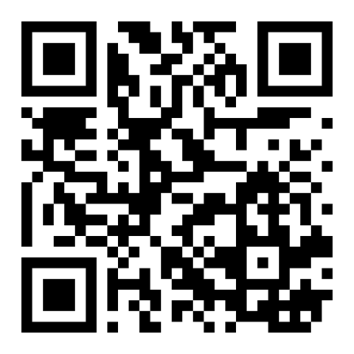
EZ4YouTech.com
Thank you
AI made easy for your business. Try free for 2 months.
Scan to book a demo or open the platform
Book a Demo
Open Platform
Scan to open
Scan to open
ez4youtech.com/contact
aiplatformusa.ez4youtech.com
Mohd Naeem · Founder & CEO · connect@ez4youtech.com · +1 (214) 404-2319

