Slide 1

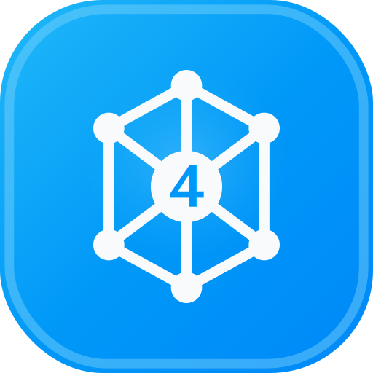
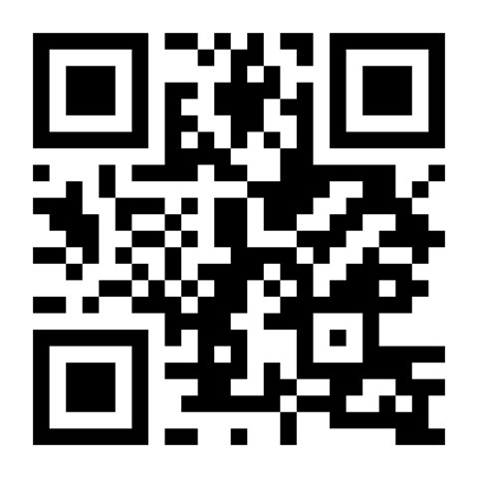
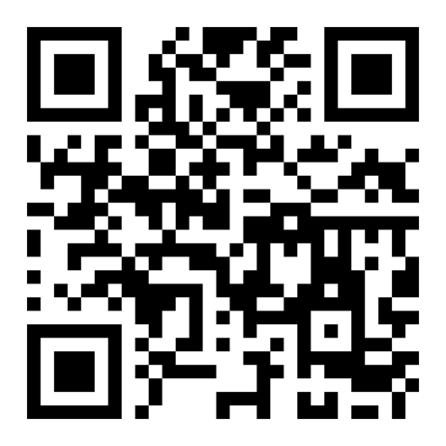

EZ4YouTech.com
www.ez4youtech.com
aiplatformusa.ez4youtech.com
Triage maintenance and tenant comms faster
AI tools for property managers: maintenance triage, lease summaries, and email in one workflow
About 15 minutes · One live workflow on the platform (~5–7 minutes)
Presented by: Mohd Naeem, Founder & CEO
25+ years in development, architecture, and DevSecOps. Enterprise experience, built for small business teams
www.ez4youtech.com · connect@ez4youtech.com · +1 (214) 404-2319

Slide 2
EZ4YouTech.com
AI MADE EASY FOR YOUR BUSINESS
Agenda
What we will cover in about 15 minutes
Section | Topics | Time
1 | Problem · What we built · Keep your tools · How it works | ~5 min
2 | Four walkthroughs (2 deep workflows · CRR · BEP) · One-time setup | ~8 min
3 | Save on AI usage · Starter Free · Paid plans | ~2 min
4 | Get involved · Q&A | Open

Slide 3
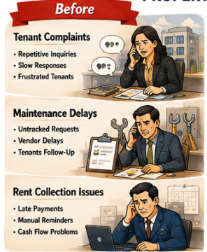
EZ4YouTech.com
AI MADE EASY FOR YOUR BUSINESS
The problem
Tackle the daily work that slows you down
AI built for your industry
✓ We augment your existing tools (PMS and vendor tools). We do not replace them.
✓ Maintenance tickets, tenant notices, and lease summaries in clear steps, not a blank ChatGPT tab
✓ Same workflow every time. Enter ticket context once, move to the next step. No re-typing between apps
✓ Human review before every send. Drafts only, not autopilot.
What we solve
Time · Money · Priority
✓ Time: hours back on triage notes and tenant email
✓ Money: renewals kept when lease outreach goes out on schedule
✓ Priority: finish tenant messages that pile up across doors

Slide 4
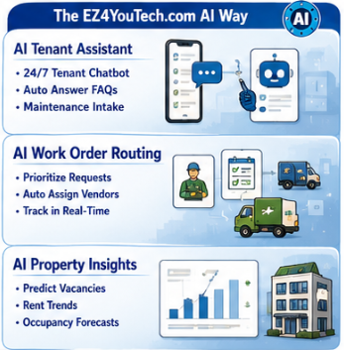
EZ4YouTech.com
AI MADE EASY FOR YOUR BUSINESS
What we built
One login, property management apps, and everyday business tools
Your company workspace
Property Management Apps
Everyday Tools
✓ One business account
✓ Property management industry chosen once
✓ Team logins by plan
✓ Maintenance triage and lease summaries
✓ Tenant notices, rent reminders, move-in checklists
✓ Client Relationship Reminders and Bulk Email Processor
✓ Fair-housing comm review (Elite — not first demo)
How It Feels on Ticket Day
✓ Open Triage maintenance requests, run step one, tap Continue. The next app opens with your draft.
✓ Maintenance Triage → branch → Client Update → Email: same path every urgent ticket
✓ Your admin connects your AI account once (OpenAI, Together, Groq, xAI, and more)
✓ We augment your existing tools (PMS and vendor tools). We do not replace them.

Slide 5
EZ4YouTech.com
AI MADE EASY FOR YOUR BUSINESS
Keep your tools · Skip the ChatGPT gaps
Sound familiar? Free ChatGPT helps, but workflow, data use, and provider lock-in still cost you
Your PMS
Vendor portals
Tickets, leases, and rent rolls stay where they are
Your existing maintenance and accounting tools
Free ChatGPT or Copilot
With EZ4YouTech.com
✗ Open a blank chat and re-type every tenant notice
✗ Consumer chat plans may use prompts for training depending on your vendor plan
✗ You are bound to one AI provider and one personal account
✓ One triage workflow: same steps every ticket with Continue
✓ Your company workspace and your AI accounts; training policies follow your provider settings
✓ Your admin connects once: OpenAI, Together, Groq, xAI, and more. Pick what you use
We augment your existing tools (PMS and vendor tools). We do not replace them.

Slide 6
EZ4YouTech.com
AI MADE EASY FOR YOUR BUSINESS
How it works
Three steps for your team. No IT project required.
1
2
3
Connect once
Triage Maintenance Requests
Try or trial
✓ Your admin links your company's AI account once
✓ The whole office shares one secure workspace
✓ Try Starter free at $0, or trial Growth on a guided pilot
✓ 2 months platform fee waived when you enroll on Growth or Full (not Starter Free)
✓ Test on real maintenance tickets before you decide
✓ Maintenance Triage → branch (urgent / routine / deferred) → Email
✓ Tap Continue between steps. Same path every ticket.
What you bring
✓ Connect your AI provider account: OpenAI, Together, Groq, xAI, and more
You pay your AI provider directly. Our platform fee covers apps and workspace, not your token usage.

Slide 7
EZ4YouTech.com
AI MADE EASY FOR YOUR BUSINESS
Walkthrough 1: Triage Maintenance Requests
Scenario 1
Solution 1: Maintenance Triage Workflow
A tenant issue arrives. Vendor notice and tenant update still need drafting.
Triage → branch → comms → email.
✗ Emergency vs routine tickets need different tone every time.
✗ Vendor dispatch notes never make it into a clear tenant message.
✗ Your PMS has the ticket. Turning it into send-ready copy still takes time.
✓ 1 · Maintenance Triage: Triage summary for PM review
✓ 2 · Branch panel: Path-specific tenant/vendor copy
✓ 3 · AI Email Automation: Send tenant email or copy to Outlook
Pick urgency path, draft tenant and vendor comms, send or paste in minutes.
Demo 1: Triage Maintenance Requests
Live on the platform · ~5 minutes · Industry workflow, then admin flash
✓ Triage Maintenance Requests: guided steps live on screen
✓ Tap Continue: context carries over, no copy-paste between tabs
✓ Admin flash: connect AI once, track usage against your provider bill
Faster Triage · Clear Tenant Updates · Less Office Typing

Slide 8
EZ4YouTech.com
AI MADE EASY FOR YOUR BUSINESS
Walkthrough 2: Summarize a Lease
Scenario 2
Solution 2: Lease Summary Workflow
Renewal season or a new move-in. The tenant email is still blank.
Summary → branch → email.
✗ Lease PDFs need a plain summary before renewal calls.
✗ Renewal vs move-in paths need different notice tone.
✗ Staff copy old lease emails instead of branching on situation.
✓ 1 · Lease Summary: Plain-language lease summary
✓ 2 · Branch panel: Path-specific tenant notice
✓ 3 · AI Email Automation: Send tenant email or copy to Outlook
Summarize lease terms, pick renewal or move-in path, send the right notice.
Demo 2: Summarize a Lease
Live on the platform · ~3 minutes · Summarize a Lease · Branching demo
✓ Open Summarize a Lease
✓ Run step one → pick branch → next app prefilled
✓ Email Draft reflects the path you chose
Clear Lease Summaries · Renewal Outreach · Less Re-Reading PDFs

Slide 9
EZ4YouTech.com
AI MADE EASY FOR YOUR BUSINESS
Walkthrough 3: Client Follow-Up
Scenario 3
Solution 3: Client Reminder Workflow
Birthdays and anniversaries slip when daily client work stacks up.
Three steps from CSV to sent email.
✗ You mean to send birthday notes, but client work wins every week.
✗ Each email is written from scratch or copied from an old template.
✗ Your CRM has the dates. Turning them into send-ready drafts still takes time.
✓ 1 · Upload CSV: Rows ready for draft generation
✓ 2 · Review Drafts: Edit anything before you approve
✓ 3 · Send: Send approved emails from your account
Review drafts, send all due reminders, or set auto-send and forget the follow-up pain.
Demo 3: Client Reminders
Live on the platform · ~2 minutes · Clients feel remembered
✓ CSV in → AI drafts birthday and anniversary emails in minutes
✓ Review and tweak drafts once: approve what you like
✓ Send from Microsoft 365: stay in touch without rewriting every note
Stay in Touch · Clients Feel Remembered · Less Manual Typing

Slide 10
EZ4YouTech.com
AI MADE EASY FOR YOUR BUSINESS
Walkthrough 4: Inbox Backlog
Scenario 4
Solution 4: Bulk Email Workflow
Saved emails and replies pile up faster than you can write them.
Three steps from inbox to sent replies.
✗ Leads and client threads wait in your inbox or saved folder.
✗ Starting each reply from scratch eats the hour you needed for client work.
✗ Copy from ChatGPT still means paste, fix tone, and send one at a time.
✓ 1 · Import: Messages queued for drafting
✓ 2 · Review Drafts: Edit any message before you approve
✓ 3 · Send: Send from Microsoft 365
Batch draft replies, approve once, send from your inbox.
Demo 4: Bulk Email
If time permits · Live on the platform · ~2 minutes · Full plan
✓ Saved emails or inbox sync → batch draft replies in minutes
✓ Review AI drafts once: fix tone before you approve
✓ Approve the batch and send from Microsoft 365: backlog cleared faster
Clear the Backlog · Faster Replies · Less Copy-Paste

Slide 11
EZ4YouTech.com
AI MADE EASY FOR YOUR BUSINESS
One-time setup
What your admin sees once: recap of the live admin flash
Company setup: admin connects once, team runs apps every day
✓ Setup tab: connect AI accounts once (OpenAI, Together, Groq, xAI, and more) · keys encrypted
✓ Provider comparison table: pick what you already use · set try-order once
✓ AI usage tab: token totals by provider and by app. Reconcile with your provider invoice
Platform fee covers apps and workspace · AI usage is a separate bill from your provider
About 15 minutes for admin to connect AI once; staff can run a triage workflow the same day.

Slide 12
EZ4YouTech.com
AI MADE EASY FOR YOUR BUSINESS
How We Help You Save on AI Usage
Pay for what you use, not a fixed chat license every month
Chat plans charge every person every month, even on quiet weeks. Your provider bill tracks actual work.
Your team's use | Pay for what you use | Fixed chat license anyway
Light Usage month 100s of emails · 100s of quotes, listings, or analyses/mo | Often about $10–25/mo on your provider bill | About $100–125/mo for 5 ChatGPT Business or Claude Team logins
Heavy Usage month 1000s of documents + 1000s of emails/mo | Often about $40–90/mo busy months often stay under $100 | Same monthly bill · Copilot add-on about $90–105/mo (+ Microsoft 365)
You pay for logins, not for every listing or email. EZ4YouTech.com shows which apps and people drive cost so you can spot waste and plan spend.
Illustrative comparison only · trademarks belong to their respective owners · EZ4YouTech.com is not affiliated with those providers · Illustrative 5-person office

Slide 13
EZ4YouTech.com
AI MADE EASY FOR YOUR BUSINESS
Try Starter Free
Trial real apps at $0 · connect your AI provider account once · no platform fee
What you get on Starter Free
Starter Free
$0/mo
✓ 5 utility + 5 industry apps for your vertical (same breadth as Growth)
✓ 35 AI runs, 12 uploads, and 50 emails per month
✓ 21-day run history · 75 MB storage · admin + 1 agent seat
✓ Connect OpenAI, Groq, Together, xAI, and more once in Setup
✓ Upgrade to Growth ($59) when daily volume and team size grow
Permanent free tier.
Connect your AI provider account.
Great for trials, demos, and solo champions.
Platform fee stays $0 on Starter Free. AI usage is billed by your provider (we do not markup tokens).

Slide 14
EZ4YouTech.com
AI MADE EASY FOR YOUR BUSINESS
Paid plans when you scale
Growth is the default for daily teams · yearly billing saves one month
Growth
Full
Enterprise
Standard
Elite
Scale
$59/mo
$119/mo
From $199/mo
✓ Up to 5 agents
✓ 10 apps · daily ops
✓ Up to 10 agents
✓ 20 apps · bulk email
✓ Up to 25 users
✓ Contact sales
Guided pilot trial (qualified teams)
✓ 2 months platform fee waived when you enroll on Growth or Full (not Starter Free)
✓ We help your admin connect your AI provider account once during onboarding
Two bills: platform fee to us · AI usage to your provider (no markup from us). See www.ez4youtech.com/pricing

Slide 15
EZ4YouTech.com
AI MADE EASY FOR YOUR BUSINESS
Your Data & Security
Storage, defense, incident response, controls, retention, and certifications
What We Store
How We Defend It
If Something Goes Wrong
✓ MongoDB Atlas and Azure Blob: files, app runs, email, CSV.
✓ Scoped to company workspace.
✓ No data sale; no model training.
✓ HTTPS-only, Key Vault, encrypted credentials, tenant isolation.
✓ Passwords hashed; keys never logged; rate limits and WAF.
✓ Connect your AI provider — your provider terms apply.
✓ Incident runbook: contain, rotate keys, preserve logs.
✓ Notify customers without undue delay; 72 hours for personal data.
✓ Cyber insurance and counsel as needed.
What You Can Do
Retention & Purge Policy
Certifications & Standards
✓ Agents clear files, analyses, runs, and import history.
✓ Admins purge org-wide workspace data from Company setup.
✓ Strong passwords; limit admin seats; review uploads.
✓ 10 most recent files, analyses, and runs per category.
✓ Email batches removed after 90 days; privacy policy on deactivation.
✓ Compare flows are session-only (no long-term vault).
✓ Enterprise-ready architecture.
✓ No SOC 2, ISO 27001, or HIPAA claim on Standard unless Enterprise contract.
Full detail: www.ez4youtech.com/platform.html#your-data-security

Slide 16
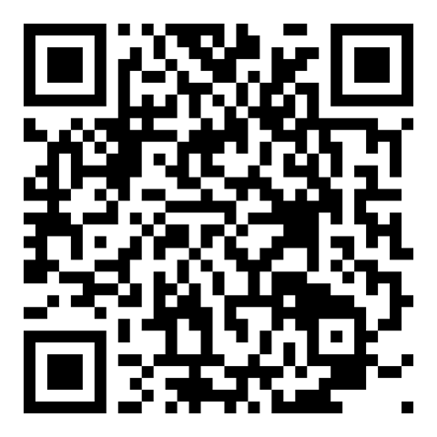
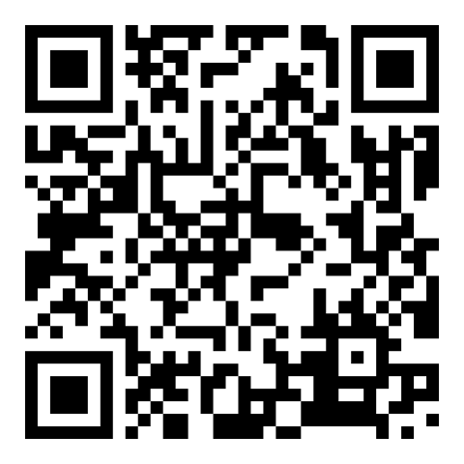
EZ4YouTech.com
AI MADE EASY FOR YOUR BUSINESS
Two ways to get involved
Thank you · Questions welcome · We follow up within 48 hours
Ready to get started?
Share an idea: we'll make it for you
Share company, industry, and team size for a guided Growth pilot follow-up (qualified teams).
Time, money, or priority: tell us daily work worth fixing and we'll shape a guided workflow.
Scan to open
Scan to open
www.ez4youtech.com/lead/intake
www.ez4youtech.com/persona/intake
We help your admin connect AI accounts once during pilot onboarding.
Thank you · Questions?
AI made easy for your business. Try free for 2 months.
connect@ez4youtech.com · +1 (214) 404-2319

