Slide 1

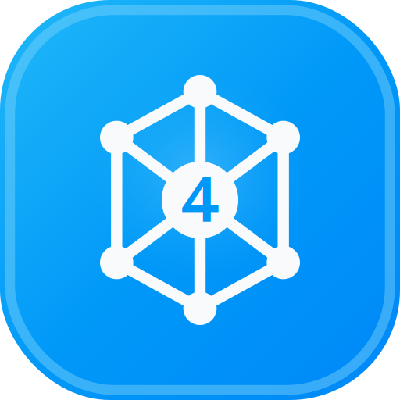
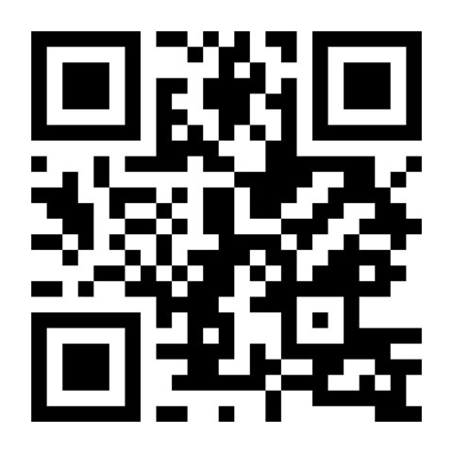
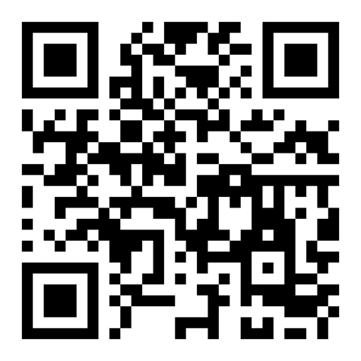

EZ4YouTech.com
www.ez4youtech.com
aiplatformusa.ez4youtech.com
Submit candidates and summarize screens faster
AI tools for staffing offices: client submittals, screen summaries, and email in one workflow
About 15 minutes · One live workflow on the platform (~5–7 minutes)
Presented by: Mohd Naeem, Founder & CEO
25+ years in development, architecture, and DevSecOps. Enterprise experience, built for small business teams
www.ez4youtech.com · connect@ez4youtech.com · +1 (214) 404-2319

Slide 2
EZ4YouTech.com
AI MADE EASY FOR YOUR BUSINESS
Agenda
What we will cover in about 15 minutes
Section | Topics | Time
1 | Problem · What we built · Keep your tools · How it works | ~5 min
2 | Four walkthroughs (2 deep workflows · CRR · BEP) · One-time setup | ~8 min
3 | Save on AI usage · Starter Free · Paid plans | ~2 min
4 | Get involved · Q&A | Open

Slide 3
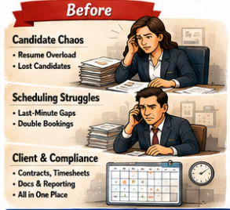
EZ4YouTech.com
AI MADE EASY FOR YOUR BUSINESS
The problem
Tackle the daily work that slows you down
AI built for your industry
✓ We augment your existing tools (ATS and CRM). We do not replace them.
✓ Submittals, screen notes, and client email in clear steps, not a blank ChatGPT tab
✓ Same workflow every time. Paste candidate context once, move to the next step. No re-typing between apps
✓ Human review before every send. Drafts only, not autopilot.
What we solve
Time · Money · Priority
✓ Time: hours back on submittal packages and screen summaries
✓ Money: reqs filled when hot candidates reach clients first
✓ Priority: finish submittals that pile up while sourcing continues

Slide 4
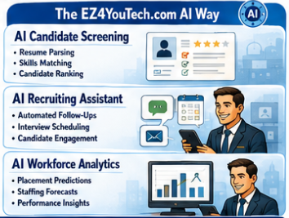
EZ4YouTech.com
AI MADE EASY FOR YOUR BUSINESS
What we built
One login, staffing & recruiting apps, and everyday business tools
Your company workspace
Staffing Apps
Everyday Tools
✓ One business account
✓ Staffing & recruiting industry chosen once
✓ Team logins by plan
✓ Client submittal email and candidate screen summary
✓ Job postings, interview guides, offer letters
✓ Client Relationship Reminders and Bulk Email Processor
✓ Skills matrix matcher (Elite — not first demo)
How It Feels on Submittal Day
✓ Open Submit a candidate, run step one, tap Continue. The next app opens with your draft.
✓ Client Submittal → branch (hot vs standard) → Email: same path every candidate
✓ Your admin connects your AI account once (OpenAI, Together, Groq, xAI, and more)
✓ We augment your existing tools (ATS and CRM). We do not replace them.

Slide 5
EZ4YouTech.com
AI MADE EASY FOR YOUR BUSINESS
Keep your tools · Skip the ChatGPT gaps
Sound familiar? Free ChatGPT helps, but workflow, data use, and provider lock-in still cost you
Your ATS / CRM
Email and calendars
Candidates, reqs, and pipelines stay where they are
Your existing client communication tools
Free ChatGPT or Copilot
With EZ4YouTech.com
✗ Open a blank chat and re-type every submittal email
✗ Consumer chat plans may use prompts for training depending on your vendor plan
✗ You are bound to one AI provider and one personal account
✓ One submittal workflow: same steps every candidate with Continue
✓ Your company workspace and your AI accounts; training policies follow your provider settings
✓ Your admin connects once: OpenAI, Together, Groq, xAI, and more. Pick what you use
We augment your existing tools (ATS and CRM). We do not replace them.

Slide 6
EZ4YouTech.com
AI MADE EASY FOR YOUR BUSINESS
How it works
Three steps for your team. No IT project required.
1
2
3
Connect once
Submit a Candidate
Try or trial
✓ Your admin links your company's AI account once
✓ The whole office shares one secure workspace
✓ Try Starter free at $0, or trial Growth on a guided pilot
✓ 2 months platform fee waived when you enroll on Growth or Full (not Starter Free)
✓ Test on real submittals before you decide
✓ Client Submittal Email → branch (hot vs standard) → Email
✓ Tap Continue between steps. Same path every candidate.
What you bring
✓ Connect your AI provider account: OpenAI, Together, Groq, xAI, and more
You pay your AI provider directly. Our platform fee covers apps and workspace, not your token usage.

Slide 7
EZ4YouTech.com
AI MADE EASY FOR YOUR BUSINESS
Walkthrough 1: Submit a Candidate
Scenario 1
Solution 1: Submittal Workflow
The client is waiting. The submittal email is still blank.
Submittal → branch → email.
✗ Hot reqs need urgency language standard submittals do not carry.
✗ Interview prep and client update are separate copy-paste steps.
✗ Your ATS has the resume. The client email still starts from scratch.
✓ 1 · Client Submittal Email: Submittal draft for recruiter review
✓ 2 · Branch panel: Path-specific urgency and interview prep
✓ 3 · AI Email Automation: Send client email or copy to ATS
Pick hot or standard path, draft submittal package, send or paste in minutes.
Demo 1: Submit a Candidate
Live on the platform · ~5 minutes · Industry workflow, then admin flash
✓ Submit a Candidate: guided steps live on screen
✓ Tap Continue: context carries over, no copy-paste between tabs
✓ Admin flash: connect AI once, track usage against your provider bill
Faster Submittals · Hot Reqs First · Less Recruiter Typing

Slide 8
EZ4YouTech.com
AI MADE EASY FOR YOUR BUSINESS
Walkthrough 2: Summarize a Screen
Scenario 2
Solution 2: Screen Summary Workflow
Phone screen done. Client feedback email still empty.
Screen summary → branch → email.
✗ Advance vs pass decisions need different client tone.
✗ Screen notes live in ATS but client email is still manual.
✗ Recruiters copy old submittals instead of branching on outcome.
✓ 1 · Candidate Screen Summary: Client-ready screen summary
✓ 2 · Branch panel: Path-specific client message
✓ 3 · AI Email Automation: Send client email or copy to ATS
Summarize the screen, pick advance or pass path, email the client.
Demo 2: Summarize a Screen
Live on the platform · ~3 minutes · Summarize a Screen · Branching demo
✓ Open Summarize a Screen
✓ Run step one → pick branch → next app prefilled
✓ Email Draft reflects the path you chose
Clear Screen Notes · Faster Client Updates · Less Recruiter Typing

Slide 9
EZ4YouTech.com
AI MADE EASY FOR YOUR BUSINESS
Walkthrough 3: Client Follow-Up
Scenario 3
Solution 3: Client Reminder Workflow
Birthdays and anniversaries slip when daily client work stacks up.
Three steps from CSV to sent email.
✗ You mean to send birthday notes, but client work wins every week.
✗ Each email is written from scratch or copied from an old template.
✗ Your CRM has the dates. Turning them into send-ready drafts still takes time.
✓ 1 · Upload CSV: Rows ready for draft generation
✓ 2 · Review Drafts: Edit anything before you approve
✓ 3 · Send: Send approved emails from your account
Review drafts, send all due reminders, or set auto-send and forget the follow-up pain.
Demo 3: Client Reminders
Live on the platform · ~2 minutes · Clients feel remembered
✓ CSV in → AI drafts birthday and anniversary emails in minutes
✓ Review and tweak drafts once: approve what you like
✓ Send from Microsoft 365: stay in touch without rewriting every note
Stay in Touch · Clients Feel Remembered · Less Manual Typing

Slide 10
EZ4YouTech.com
AI MADE EASY FOR YOUR BUSINESS
Walkthrough 4: Inbox Backlog
Scenario 4
Solution 4: Bulk Email Workflow
Saved emails and replies pile up faster than you can write them.
Three steps from inbox to sent replies.
✗ Leads and client threads wait in your inbox or saved folder.
✗ Starting each reply from scratch eats the hour you needed for client work.
✗ Copy from ChatGPT still means paste, fix tone, and send one at a time.
✓ 1 · Import: Messages queued for drafting
✓ 2 · Review Drafts: Edit any message before you approve
✓ 3 · Send: Send from Microsoft 365
Batch draft replies, approve once, send from your inbox.
Demo 4: Bulk Email
If time permits · Live on the platform · ~2 minutes · Full plan
✓ Saved emails or inbox sync → batch draft replies in minutes
✓ Review AI drafts once: fix tone before you approve
✓ Approve the batch and send from Microsoft 365: backlog cleared faster
Clear the Backlog · Faster Replies · Less Copy-Paste

Slide 11
EZ4YouTech.com
AI MADE EASY FOR YOUR BUSINESS
One-time setup
What your admin sees once: recap of the live admin flash
Company setup: admin connects once, team runs apps every day
✓ Setup tab: connect AI accounts once (OpenAI, Together, Groq, xAI, and more) · keys encrypted
✓ Provider comparison table: pick what you already use · set try-order once
✓ AI usage tab: token totals by provider and by app. Reconcile with your provider invoice
Platform fee covers apps and workspace · AI usage is a separate bill from your provider
About 15 minutes for admin to connect AI once; recruiters can run a submittal the same day.

Slide 12
EZ4YouTech.com
AI MADE EASY FOR YOUR BUSINESS
How We Help You Save on AI Usage
Pay for what you use, not a fixed chat license every month
Chat plans charge every person every month, even on quiet weeks. Your provider bill tracks actual work.
Your team's use | Pay for what you use | Fixed chat license anyway
Light Usage month 100s of emails · 100s of quotes, listings, or analyses/mo | Often about $10–25/mo on your provider bill | About $100–125/mo for 5 ChatGPT Business or Claude Team logins
Heavy Usage month 1000s of documents + 1000s of emails/mo | Often about $40–90/mo busy months often stay under $100 | Same monthly bill · Copilot add-on about $90–105/mo (+ Microsoft 365)
You pay for logins, not for every listing or email. EZ4YouTech.com shows which apps and people drive cost so you can spot waste and plan spend.
Illustrative comparison only · trademarks belong to their respective owners · EZ4YouTech.com is not affiliated with those providers · Illustrative 5-person office

Slide 13
EZ4YouTech.com
AI MADE EASY FOR YOUR BUSINESS
Try Starter Free
Trial real apps at $0 · connect your AI provider account once · no platform fee
What you get on Starter Free
Starter Free
$0/mo
✓ 5 utility + 5 industry apps for your vertical (same breadth as Growth)
✓ 35 AI runs, 12 uploads, and 50 emails per month
✓ 21-day run history · 75 MB storage · admin + 1 agent seat
✓ Connect OpenAI, Groq, Together, xAI, and more once in Setup
✓ Upgrade to Growth ($59) when daily volume and team size grow
Permanent free tier.
Connect your AI provider account.
Great for trials, demos, and solo champions.
Platform fee stays $0 on Starter Free. AI usage is billed by your provider (we do not markup tokens).

Slide 14
EZ4YouTech.com
AI MADE EASY FOR YOUR BUSINESS
Paid plans when you scale
Growth is the default for daily teams · yearly billing saves one month
Growth
Full
Enterprise
Standard
Elite
Scale
$59/mo
$119/mo
From $199/mo
✓ Up to 5 agents
✓ 10 apps · daily ops
✓ Up to 10 agents
✓ 20 apps · bulk email
✓ Up to 25 users
✓ Contact sales
Guided pilot trial (qualified teams)
✓ 2 months platform fee waived when you enroll on Growth or Full (not Starter Free)
✓ We help your admin connect your AI provider account once during onboarding
Two bills: platform fee to us · AI usage to your provider (no markup from us). See www.ez4youtech.com/pricing

Slide 15
EZ4YouTech.com
AI MADE EASY FOR YOUR BUSINESS
Your Data & Security
Storage, defense, incident response, controls, retention, and certifications
What We Store
How We Defend It
If Something Goes Wrong
✓ MongoDB Atlas and Azure Blob: files, app runs, email, CSV.
✓ Scoped to company workspace.
✓ No data sale; no model training.
✓ HTTPS-only, Key Vault, encrypted credentials, tenant isolation.
✓ Passwords hashed; keys never logged; rate limits and WAF.
✓ Connect your AI provider — your provider terms apply.
✓ Incident runbook: contain, rotate keys, preserve logs.
✓ Notify customers without undue delay; 72 hours for personal data.
✓ Cyber insurance and counsel as needed.
What You Can Do
Retention & Purge Policy
Certifications & Standards
✓ Agents clear files, analyses, runs, and import history.
✓ Admins purge org-wide workspace data from Company setup.
✓ Strong passwords; limit admin seats; review uploads.
✓ 10 most recent files, analyses, and runs per category.
✓ Email batches removed after 90 days; privacy policy on deactivation.
✓ Compare flows are session-only (no long-term vault).
✓ Enterprise-ready architecture.
✓ No SOC 2, ISO 27001, or HIPAA claim on Standard unless Enterprise contract.
Full detail: www.ez4youtech.com/platform.html#your-data-security

Slide 16
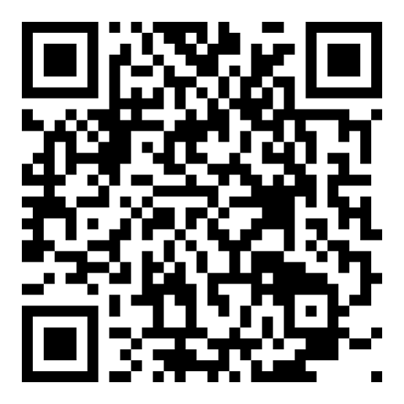
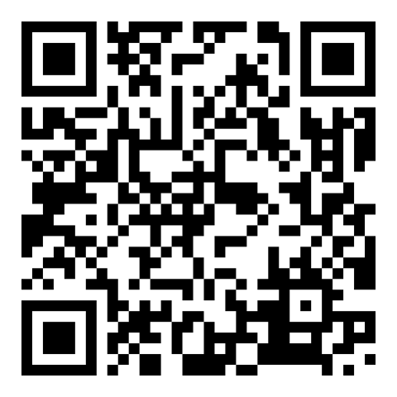
EZ4YouTech.com
AI MADE EASY FOR YOUR BUSINESS
Two ways to get involved
Thank you · Questions welcome · We follow up within 48 hours
Ready to get started?
Share an idea: we'll make it for you
Share company, industry, and team size for a guided Growth pilot follow-up (qualified teams).
Time, money, or priority: tell us daily work worth fixing and we'll shape a guided workflow.
Scan to open
Scan to open
www.ez4youtech.com/lead/intake
www.ez4youtech.com/persona/intake
We help your admin connect AI accounts once during pilot onboarding.
Thank you · Questions?
AI made easy for your business. Try free for 2 months.
connect@ez4youtech.com · +1 (214) 404-2319

